Slide 1


Contents Analysis:
Social Buzz

Slide 2


Today's agenda
Project recap
Problem
Process
Insights
Summary

Slide 3

Social Buzz is fast growing technology unicorn that need to adapt quickly to its global scale. Accenture has begun a 3 month POC focusing on these tasks:
An audit Social Buzz’s big data practice
Recommendations for a successful IPO
Analysis to find Social Buzz’s top 5 most popular categories of content
Project Recap

Slide 4

Problem
Over 100000 posts per day
36.500.000 pieces content per year!
But how to capitalize on it when there is so much
Analysis to find Social Buzz’s top 5 most popular categories of content

Slide 5
Process
1
Data Understanding
2
Data Cleaning
3
Data Modelling
4
Data Analysis
5
Uncover Insights

Slide 6

Insights
I6
I897
May
UNIQUE CATEGORIES
REACTIONS TO “ANIMAL” POSTS
MONTH WITH MOST POSTS

Slide 7
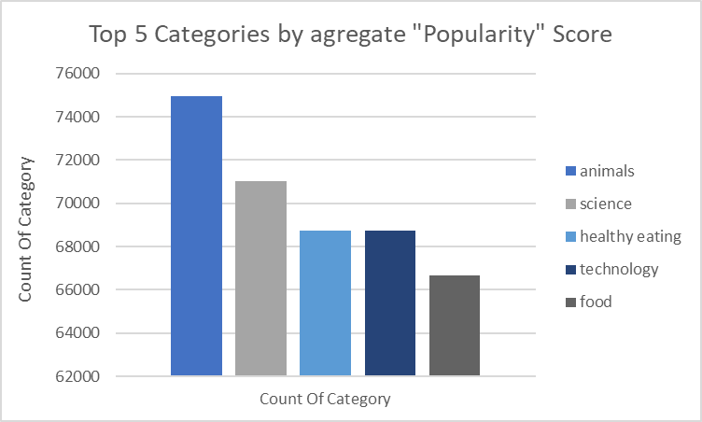

Slide 8
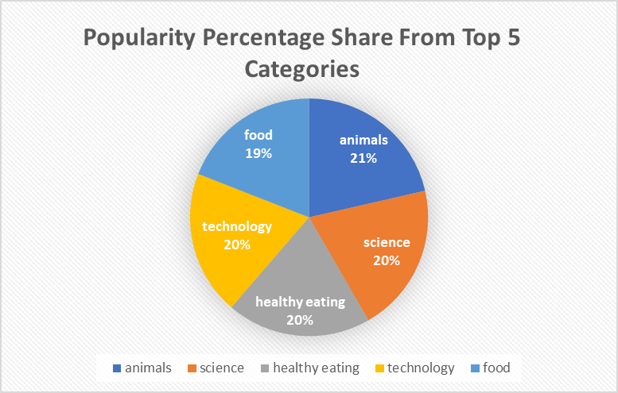

Slide 9

Analysis
Animals and science are the two most popular categories of content, showing that people enjoy “real-life” and “factual” content the most.
Insight
Food is a common theme with the top 5 categories with “Healthy Eating” ranking the Highest. This may give an indication to the audience within your user base. You could use this insight to create a campaign and work with healthy eating brands to boost user engagement.
Summary

Slide 10
Thank you!
ANY QUESTIONS?

